Slide 1
YesFuture
Automatic Packaging Machine

Slide 2
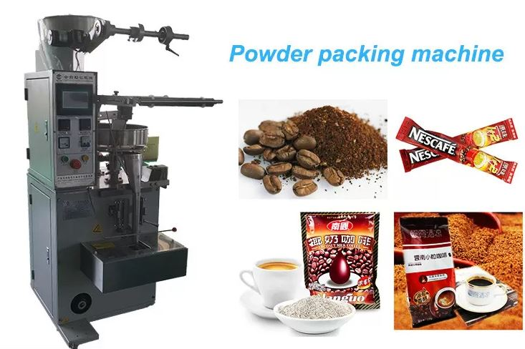
Automatic Packaging Machine
The automatic packaging machine is used to package items automatically without the need for wastıng human resources. In this way, the employer can produce hundreds of products with a single machine.

Slide 3
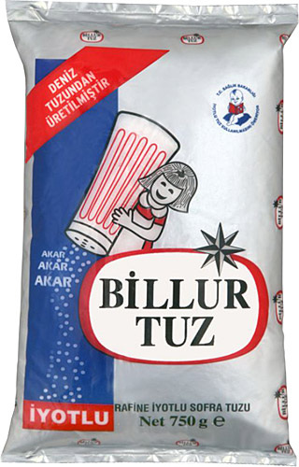
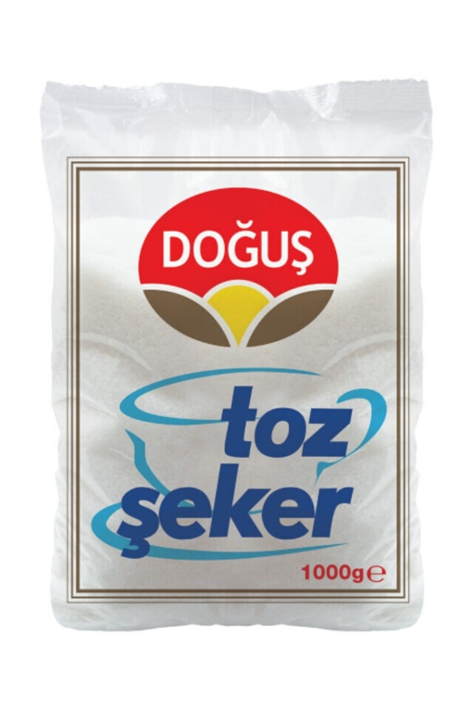
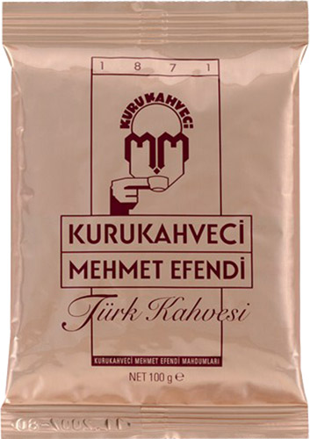
Ne Paketleyebiliriz?
Coffee, flour, sugar, salt..
Plastic Products
Liquid Products

Slide 4
How it works?
There was a hopper at the top of our machine. The products are discharged into this chamber. The number of grams of the products to be packaged is entered on the screen. For example, let's say we want to pack 50 grams of coffee. The coffee powders poured into the upper chamber are transmitted to the front cover box by vibrating with the weight sensor located at the bottom of the chamber, until the cover is filled with 50 grams. The hopper continues to vibrate until it reaches 50 grams, and when it reaches the target, the lid is opened and the coffee grounds are emptied. This machine continues to work in this way until the user stops it.

Slide 5
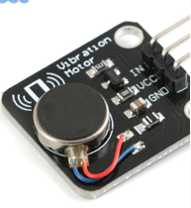
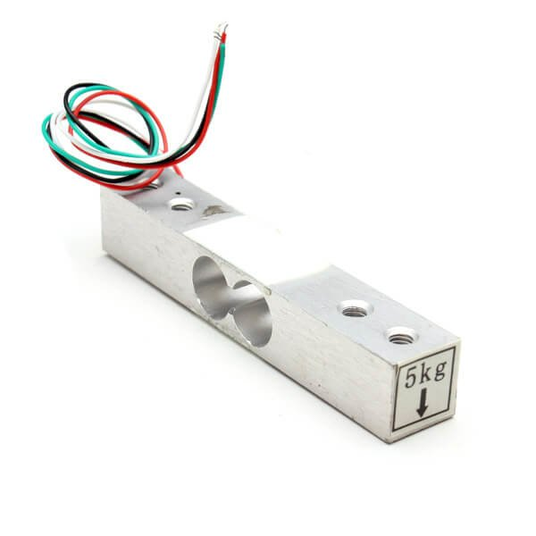
VİBRATİON SENSOR - LOAD CELL

Slide 6
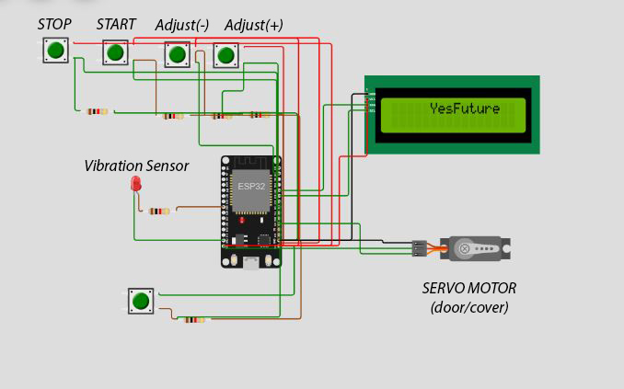
DEVRE ŞEMASI

Slide 7
Thank you for listening
Team Members
OMER CEYHAN(1810206064)
AHMED ABUSEARIAH
AHMED ELHALIB
SOMAYA

